Slide 1
Introduction to Direct nuclear reaction
Y.-H. Song(RISP,IBS)
2020.Aug.20 라온활용학교

Slide 2
Disclaimer
This is an introduction to direct nuclear reaction theory
Also, I will introduce briefly the GUI code which is under development.
The aim of the code is to make it easy and intuitive to do a simple nuclear reaction calculation.

Slide 3

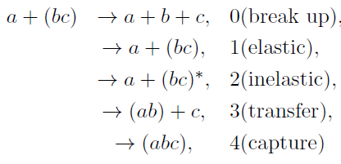
Partition, Channel
Reaction Q-value:
(Released energy)
Suppose target is composed with two particle
(Mass) partition : projectile (Z,A)
and target (Z,A) combination
Channels : projectile and target quantum states
(spin, parity, excited states )
many-body problem , (Ap+At)-system.
Many different reaction channels.
We have to use approximations/simplification.
( reduce the problem into few-body problem, reduce relevant channels, etc. )

Slide 4
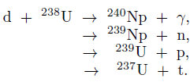
Conservation laws in nuclear reaction
Baryon Number
Charge
Energy and linear momentum
Total angular momentum
Parity
(approximate) Isospin
initial S-wave capture → L=2,3,4 final states , parity imply L=3

Slide 5
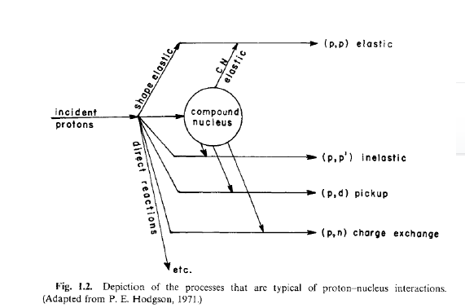

Direct reaction and Compound Nucleus reaction
Direct reaction(D) and
Compound nucleus(CN) reaction
Reaction time: D → short
CN → long
Contact: D→ glancing contact (surface)
CN→ involve whole nucleus
Angular distribution:
D→ forward peak
CN→ isotropic
Independence hypothesis of CN reaction

Slide 6




wave function
Simplification of many-body wave function :
sum of channel wave functions
(bound state wave functions of projectile and target)
and (wave function for relative motion)
Suppose Bound-state wave function is known from structure model
Relative wave function determine the flux → cross section
b
a
A
B

Slide 7
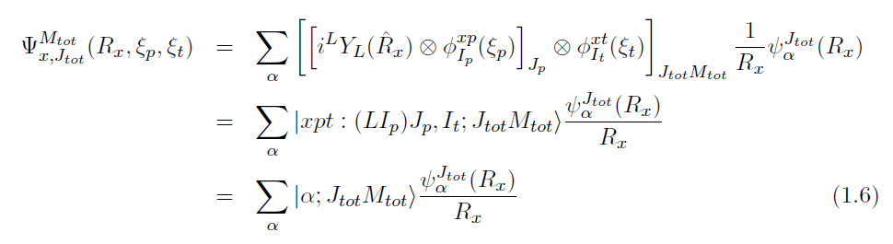
Wave function
Wave function of a channel with specific total angular momentum : J= L+Ip+It
J-basis (LS ) scheme : add (orbital angular momentum)+(projectile spin) first
→ Diagonal for the (projectile) spin-orbit interaction.
S-basis (JJ ) scheme : add (projectile spin)+(target spin) first
Conversion between the two scheme can be done

Slide 8

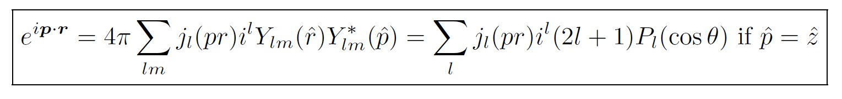
Wave function
Partial wave expansion of scattering wave:
Scattering wave function with incident momentum k
and initial spin states of projectile and target
Recall
Our Object: obtain (relative) wave function in each channel
and compute the cross section in each channel

Slide 9



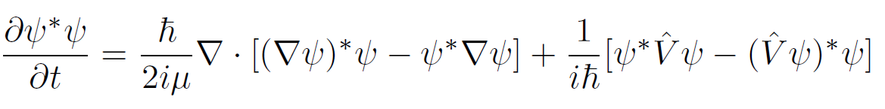

Current
From continuity eq. and Schrodinger eq.
The last term vanishes for local Hermitian interaction.
In general, interactions are non-local.
Free Current density
Plane wave Case : (density)*(velocity)

Slide 10
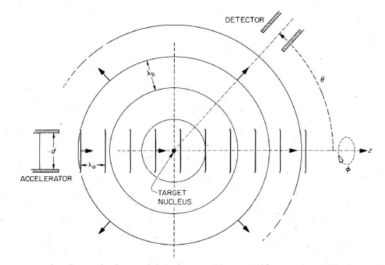
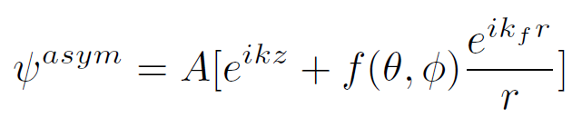
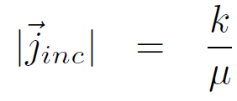
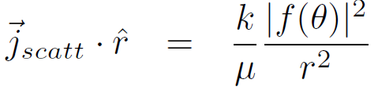
Asymptotic Form of scattering wave
If interaction have finite range,
Asymptotic boundary condition
Incident wave + scattered wave
f : Scattering amplitude
f=0 , if there is no potential
(Satchler Fig. 3.1)
Then incident flux and scattered flux at large distance
(H.W.) show this

Slide 11
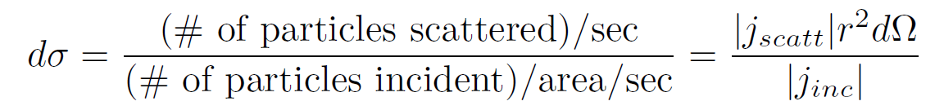
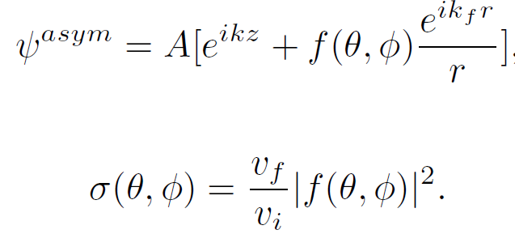
Cross section
Cross section for the scattering into solid angle
Differential Cross section
Angle Integrated Cross section → “total” cross section
We will use “total” cross section
as a sum of elastic cross section and non-elastic cross section.

Slide 12
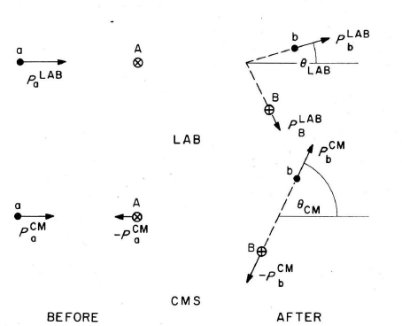
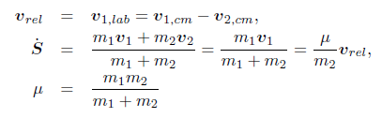

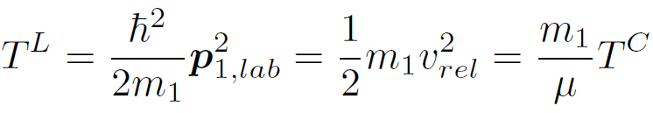
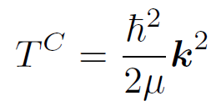

Kinematics
Before collision
(Satchler fig2.1)
In elastic scattering, (kinetic) energy is conserved.

Slide 13
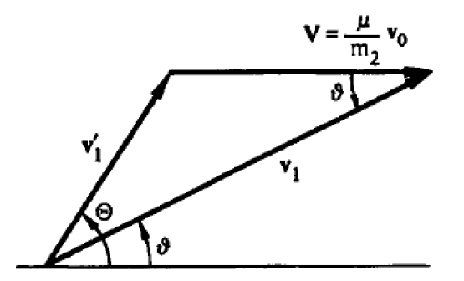

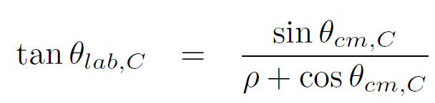
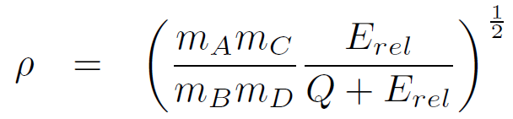


Kinematics
vcm
vlab
Q= (mA+mB –mC -mD) c^2,
Q=0 for elastic scattering
Cross section at lab frame and at CM frame
(H.W.) prove the relation between
Lab angle and CM angle
(H.W.) relativistic kinematic relations

Slide 14

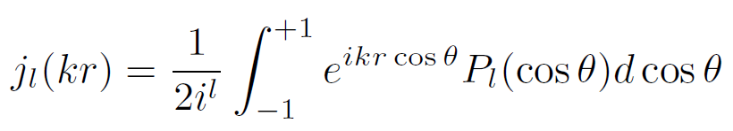
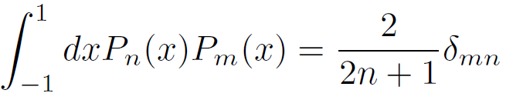
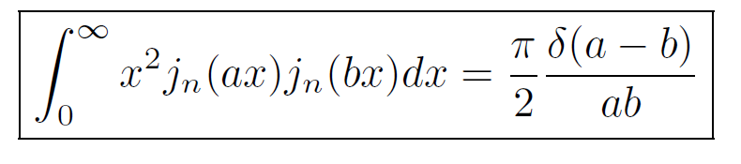
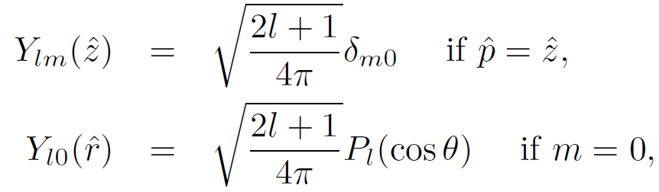
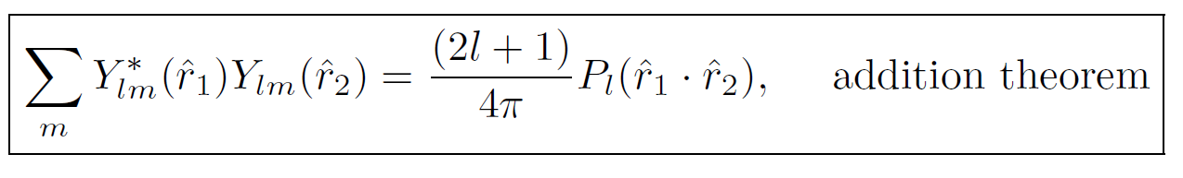
Partial Wave expansion of plane wave
(H.W.) Prove this relation
Useful equations

Slide 15
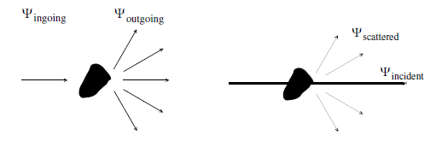
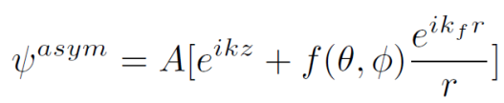
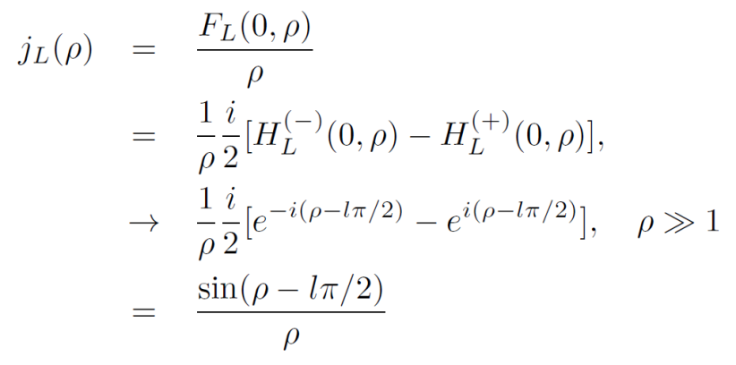
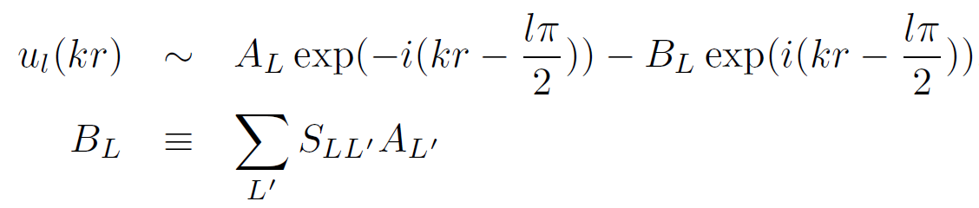

S-matrix
Incident wave contains both ingoing and outgoing wave
Scattered wave should only contain outgoing wave
Thus, the effect of scattering may be expressed as
(Complex) S-matrix to the outgoing wave part
Unitarity implies |S|=1

Slide 16
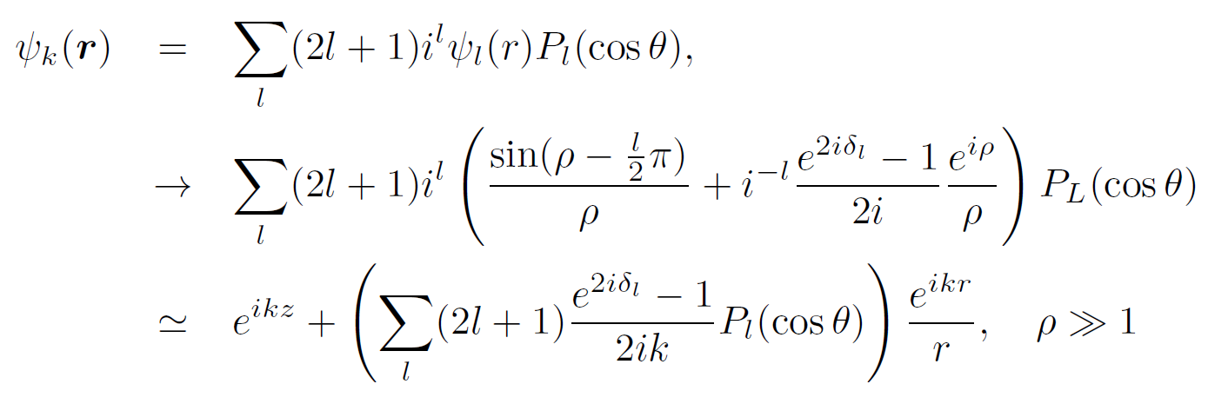
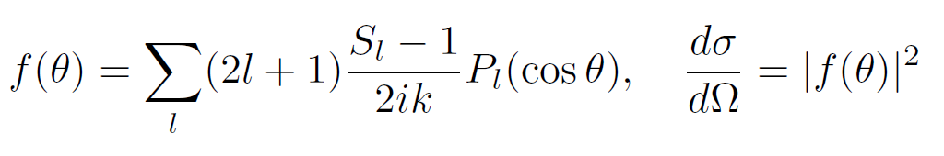
Phase shift, S-matrix, Scattering amplitude and Cross section
Using this relation, we can relate the S-matrix (phase shift) with the
Asymptotic form of wave function, scattering amplitude
And finally cross section.

Slide 17


Coulomb functions
Coulomb-Hankel function
Asymptotic Forms
Coulomb phase shift
For the moment, let us ignore Coulomb interaction, eta=0.
Thus, Coulomb functions and Coulomb-Hankel functions simply corresponds to
Spherical Bessel functions and (ingoing, outgoing waves).

Slide 18
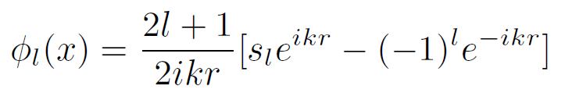
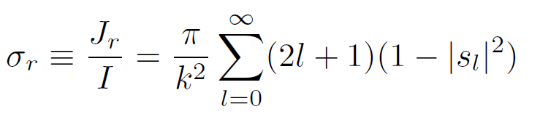
Reaction(absorption) Cross section
In fact, the optical theorem holds even when the phase shift is complex ( |s|<1, thus disappearing flux ) , if we define
(total cross section)=(elastic cross section)+(reaction cross section)
(reaction cross section) describe the disappearance of flux ~ absorption
~ Complex potential
Total flux into the sphere:
Reaction cross section = ratio between (incident flux) and (disappeared flux)

Slide 19
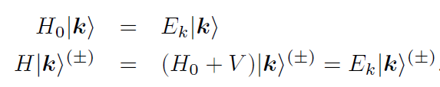
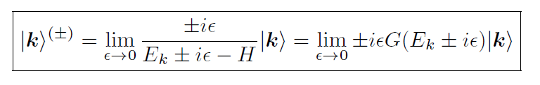
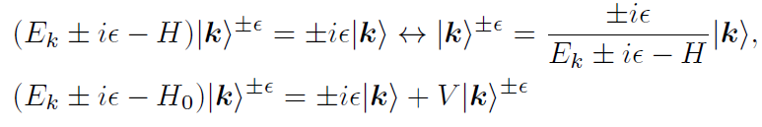


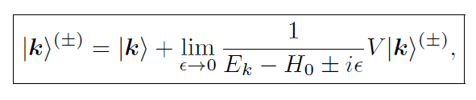

Formal theory of scattering
Lippmann-Schwinger equation
→ Coordinate space representation

Slide 20


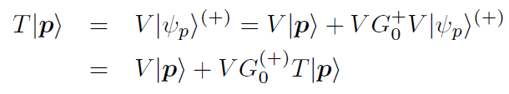
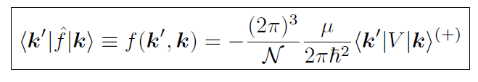
LS equation for t-matrix
T-operator

Slide 21
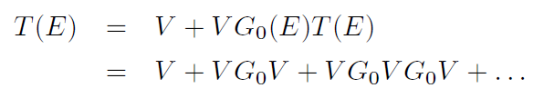
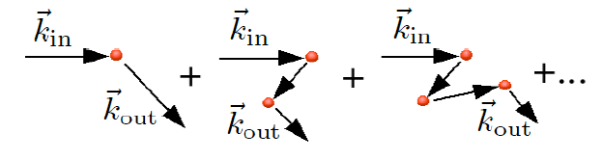
Born Series
If potential is strong, the born series may have bad convergence.
Distorted Wave Born Approximation can be used
( Non-perturbative treatment of part of interaction)

Slide 22
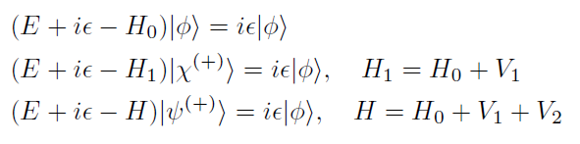
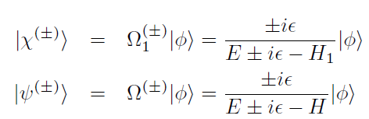

Two potential formula
Suppose there are strong potential and weak potential
(Plane wave)
(Distorted Wave)
(Full scattering wave)

Slide 23
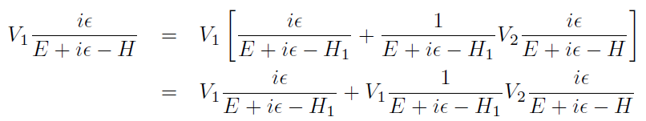


Two potential formula

Slide 24
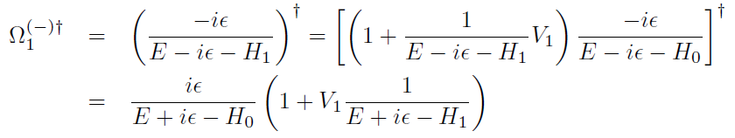


Two potential formula
Thus we get two-potential formula
Distorted Wave Born Approximation(DWBA)

Slide 25


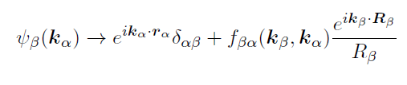

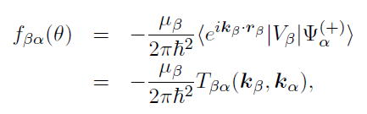
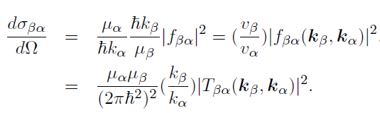
Cross section
S-matrix (for reaction)
Cross section (for reactions)

Slide 26
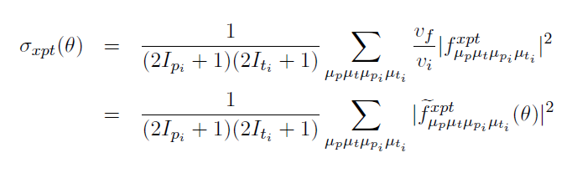
Cross section
Unpolarized (spin averaged) cross section
How to compute the channel wave function?

Slide 27


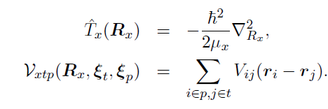



Coupled Reaction Channel equation
Model space wave function
Suppose we separate full many-body Hamiltonian
Into (projectile)+(target)+(relative)
Expand for each channels

Slide 28
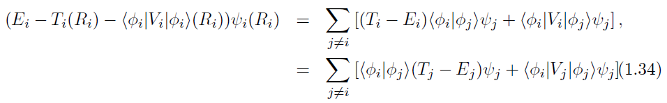



Coupled Reaction Channel equation
Couplings involve an integration of bound state wave functions and potential
Over internal coordinates.
By solving Coupled Reaction Channel equation,
We get the channel wave functions, and thus reaction cross section.
However, it is quite complicate equations → Simplification?
Optical potential

Slide 29




Optical Potential
Projection operator
Effective Hamiltonian
Acts only on P(model space)
Complex
Negative imaginary potential
→ loss of a probability flux
from model space
4. non-local
Theoretically we may compute effective Hamiltonian.
In practice, effective potential are fitted to experiments.
Optical potential in elastic channel simulates the neglected model space contributions

Slide 30

Elastic scattering (Optical Model)
Complex optical potential are usually fitted to reproduce elastic scattering data.
In optical model of elastic scattering,
we approximate all other reaction channel effects
into a complex optical potential.
Woods-Saxon Form is commonly used for parametrization
Optical potentials
Surface potential, spin-spin interaction and so on…
Negative imaginary potential implies reduction in flux in elastic channel
→ Absorption cross section
(H.W.) prove this is the same
As the reaction cross section
For spherical potential
(hint) Use Schrodinger eq.

Slide 31






Elastic scattering (Optical Model)
Coulomb
a: diffuseness
Real part
Imaginary part
Spin-orbit interaction

Slide 32
Elastic scattering (Optical Model)
Typical values are Vr~ 40-50 MeV, Vi~ 10-20 MeV, Vso~ 5-8 MeV
r ~ 1.2 fm, a~ 0.6 fm
Parameters depends on projectile, target and energy
Sometimes global optical potential available or
one can use folding potential
Global Optical Potentials: RIPL-3 https://www-nds.iaea.org/RIPL-3/
Folded potential: nuclear density + effective NN interaction(M3Y , JLM etc. )
single folding or double folding

Slide 33

Elastic scattering (Optical Model)
Nuclear Reaction Video (NRV) provides easy access to some nuclear reaction calculation
http://nrv.jinr.ru/nrv/
Typical
energy dependence
(A.M. Moro’s lecture)

Slide 34

Inelastic scattering (Rotational Model)
Coupling to inelastic channel requires structure information (models)
For inelastic scattering: Commonly used models are
Collective Excitation Model : Rotational or Vibrational
Or
Single Particle Excitation Model
Rotational Model

Slide 35




Inelastic scattering (Rotational Model)
Rotational Energy of deformed nuclei
(even-even or odd-odd Nuclei case)
I
K
Symmetry axis
I : spin of nuclei
K: bandhead ,
Spin projection at body-fixed frame
Deformed Nucleus
In z’-axis, R0(1+beta)
Deformed potential
R

Slide 36




Inelastic scattering (Rotational Model)
Axially deformed case : deformation length, fractional deformation
Skipping calculation of transition matrix for change of rotational state
In simple rotational model,
Deformation length(or beta) is an input.
Deformation → Coulomb and Nuclear
(may differ)
Reduced transition probability

Slide 37





Inelastic scattering (Single Particle Excitation Model)
Model the bound state of a nucleus as (core)+(valence particle)
Bound state is characterized by (valence particle wave function)
Inelastic excitation corresponds to the change in bound state wave function
v
r
c
R
T

Slide 38

Inelastic scattering (Single Particle Excitation Model)
In some code,
The last two terms are neglected
DWBA calculation requires
Kinematic info ( incident energy, Q-value)
Initial and Final State, transferred angular momentum
Optical potential between projectile and target
Initial and final Bound state wave function → binding interaction, spectroscopic factor
Inelastic (residual) Potential
DWBA codes are available: DWUCK, TWOSTP, …
https://people.nscl.msu.edu/~brown/reaction-codes/

Slide 39







Transfer reaction
Consider the stripping reaction,
p(=c+n)+c’ → c+t(=c’+n)
In rearrangement,
initial and final partition is different.
n
c
c’
p=c+n
t=n+c’
Need to evaluate

Slide 40

Transfer reaction
n
In general this coupling gives
Non-local kernel
Finite-range transfers
Local approximation of kernel
Zero-range transfers
(treat interaction potential
as approximately zero range )
c
c’
p=c+n
t=n+c’

Slide 41
Transfer reaction
DWBA amplitude involves integration of kernel with channel wave functions,
We can change the variables, into
So that the kernel can be calculated by the integration over angles of R and R’

Slide 42


Transfer reaction (Zero range)
In some case,
When remnant terms are negligible
Wave function are all s-waves
Interaction potential is approximately zero range
In some code using ZR approximation,
input becomes D0
instead of transition potential and bound state wave function
Typical value for deuteron

Slide 43

Transfer reaction
In some code,
The last two terms are neglected
DWBA calculation requires
Kinematic info ( incident energy, Q-value)
Initial and Final State, transferred angular momentum
Optical potential between projectile and target
Initial and final Bound state wave function → binding interaction, spectroscopic factor
Transition Potential
DWBA codes are available: DWUCK, TWOSTP, …
https://people.nscl.msu.edu/~brown/reaction-codes/

Slide 44





Overlap function, Spectroscopic factor, ANC
Overlap function: For B=A+v
In principle, overlap function comes from many-body calculation.
It is common to use a simple single-particle picture.
To be exact, Anti-symmetry
of wave function have to be considered
Spectroscopic factor
B
r
A
Spectroscopic amplitude

Slide 45




Overlap function, Spectroscopic factor, ANC
From the nucleon separation energy, we expect
Asymptotic Normalization Constant
If we approximate many-body overlap function into s.p. wave function
Well-depth prescription is
Commonly used for s.p.w.
Single particle ANC

Slide 46


Transfer reaction as a spectroscopic tool
Transfer reaction cross section is sensitive
To the transferred angular momentum
(1) By analyzing angular distribution,
one can determine
the transferred orbital angular momentum
The quantum number of s.p. states
(2) In a s.p. picture,
one can extract S.F. from experiments
→ Spectroscopic information
DWBA codes are available: DWUCK, TWOSTP, …
https://people.nscl.msu.edu/~brown/reaction-codes/

Slide 47
Halo nuclei
Deuteron is a weakly bound nuclei. → Couplings to break up channel can be important.
Many Rare isotope are weakly bound, Especially Halo nuclei. → Couplings to break up channel can be important.
One of ways to include break up channel effects in transfer reaction is to use ADWBA.
Another way is to use CDCC.
Recently, there are efforts to use ab-initio or Faddeev method for transfer reaction.

Slide 48



Break up Channel effects
(elastic scattering example)

Slide 49
Development of GUI for reaction calculation
Currently, developing a simple GUI program for RAON Users to do reaction calculation.
At the moment, it is aimed to do DWBA calculation for elastic , in-elastic, transfer reaction in a very simple structure model.
Later, plan to add radiative capture, fusion reaction and coupled channel methods(also ADWA, CDCC).
Also, trying to include several useful functions for the convenience of Users.

